Slide 1
Conditional Statements & Loops
BDPA INDY Sites
02/29/2020

Slide 2

Quick Quiz: Name these operators!
And
Strict Equality
Increment
Modulus
Conditional Selection
Or
&&
===
++
%
?
||

Slide 3
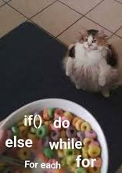
Control Structures
There are for basic types of control structures in JavaScript: the if statement, the while loop, the for loop and the case statement.
Each control structure manipulates a block of JavaScript expressions beginning with { and ending with }

Slide 4


Boolean Operators
= = Equality
=== Strict Equality
! = Inequality
! Logical NOT
&& Logical AND
|| Logical OR
? Conditional Selection

Slide 5
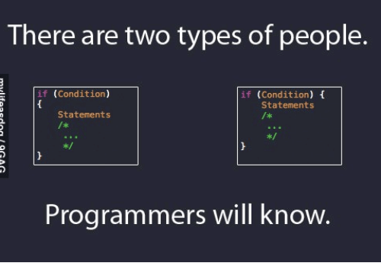
The If Statement
The if statement allows JavaScript programmers to a make decision
Use an if statement whenever you come to a “fork” in the program

Slide 6
Nested if statements
If ( x = = 10)
{ y = x*x;
}
If else ( x <10)
{
y = 10
}
else
{ x = 0;
}
The else & else if statements allows programmers to further “fork” a decision.
An if statement can stand alone but any else if must be followed with an else

Slide 7
Nested Loops
Similar to nested if statements, loops can be nested as well
That is, the body of a loop can contain another loop
For each iteration of the outer loop, the inner loop iterates completely
count1 = 1;
while (count1 <= 10){
count2 = 1;
while (count2 <= 20){
System.out.println ("Here");
count2++;
}
count1++;
}

Slide 8
Switch Statements
Based on the value of the expression, the matching case’s statements are executed
The default case is similar to an else statement
Multiple cases can share the same block of statements
A while statement has the following syntax:
switch(expression) { case x: statements break; case y: statements break; default: statements }

Slide 9
Switch Statement Examples
switch (new Date().getDay()) { case 6: text = "Today is Saturday"; break; case 0: text = "Today is Sunday"; break; default: text = "Looking forward to the Weekend"; }
switch (new Date().getDay()) { case 4: case 5: text = "Soon it is Weekend"; break; case 0: case 6: text = "It is Weekend"; break; default: text = "Looking forward to the Weekend"; }

Slide 10
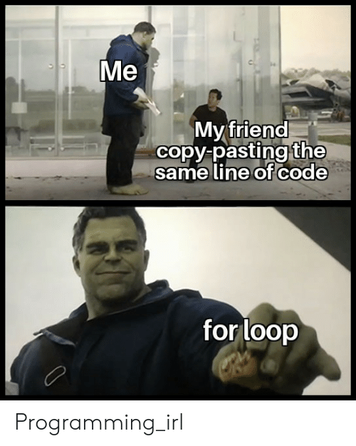
Repetition Statements
0
Repetition statements allow a program to run a statement multiple times consecutively
They are often referred to as loops
Like conditional statements, they are controlled by boolean expressions
Java has 3 different types of loops:
the while loop
the do loop
the for loop

Slide 11
The while Loop syntax
0
A while statement has the following syntax:
while ( condition ){
statements;
}
condition
evaluated
false
true
If the condition is true, the statement is executed
Then the condition is evaluated again, and if it is still true, the statement is executed again
The statement is executed repeatedly until the condition becomes false
statement

Slide 12
While Loop Examples
0
int count = 1;
while (count <= 3){
Console.log(count);
count++;
}
int count = 1;
while (count < 2){
Console.log (count);
count++;
}

Slide 13
While Loop Examples
0
int count = 2;
while (count <= 3){
Console.log (count);
count--;
}
Infinite Loop

Slide 14
Infinite Loops
The body of a while loop eventually must make the condition false
If not, it is called an infinite loop, which will execute until the user interrupts the program
This is a common logical error
You should always double check the logic of a program to ensure that your loops will terminate normally
*Dramatization of the infinite loop chaos

Slide 15
The Do while Loop syntax
0
A while statement has the following syntax:
do{
statements;
}
while ( condition )
condition
evaluated
true
The statement is executed once initially, and then the condition is evaluated.
The statement is executed repeatedly until the condition becomes false
statement
false

Slide 16
Do While Loop Examples
0
int count = 0;
do{
count++;
Console.log (count);
} while (count < 3);
int count = 100;
do{
count++;
Console.log (count);
} while (count < 3);

